Slide 1

CSE332
Industry Ethics and Legal Issues
Lecture #0

Slide 2
Course Details
CSE332
L T P – 2 0 0 [Two lectures/week]
Credit- 2

Slide 3
Vision
To be a globally recognized school through excellence in teaching, learning and research for creating Computer Science professionals, leaders and entrepreneurs of future contributing to society and industry for sustainable growth.
Notes:
Aim to become a globally recognized school
Focus on quality education, research, leadership, and entrepreneurship
Encourage sustainable and ethical growth
Example
For example, creating software startups that solve real social problems like healthcare or education, not just profit-driven apps.

Slide 4
Mission
To build computational skills through hands-on and practice-based learning with measurable outcomes.
To establish a strong connect with industry for in-demand technology driven curriculum.
To build the infrastructure for meaningful research around societal problems.
To nurture future leaders through research-infused education and lifelong learning.
To create smart and ethical professionals and entrepreneurs who are recognized globally
Notes:
Build strong computational and practical skills
Maintain a strong industry connection
Promote ethical behavior and lifelong learning
Encourage research-driven education
Example
Students learning about patents and startups helps them move from classroom ideas to real products.

Slide 5
Course Outcomes
CO1 :: Apply ethical principles and integrity in professional, business, and IT practices
CO2 :: Examine intellectual property concepts and their importance in innovation protection
CO3 :: Identify startup schemes, funding sources, and legal support mechanisms.
CO4 :: Apply startup planning techniques to develop an IT business plan.
CO5 :: Analyze trends, technologies, and diversity in the IT and ITES industry.
CO6 :: Analyze ethical, legal, and security issues in information security.
Notes:
CO1 – Ethics in Professional Life
Apply ethical principles in IT and business.
Example
Not copying code from GitHub without a license is ethical practice.
CO2 – Intellectual Property (IP)
Understand patents, copyrights, and trademarks.
Example
Registering a mobile app logo as a trademark to protect it from copying.
CO3 – Startup Schemes & Funding
Learn about government schemes and funding options.
Example
Startup India benefits like tax exemption and mentorship support.
CO4 – Startup Planning
Learn how to prepare a basic IT startup business plan.
Example
Planning cost, marketing strategy, and revenue for a software product.
CO5 – IT & ITES Industry Trends
Understand product-based vs service-based companies.
Example
Infosys as service-based, Google as product-based.
CO6 – Security, Legal & Ethical Issues
Study cyber laws and security responsibilities.
Example
Legal consequences of hacking or data breaches.

Slide 6
Program Outcomes
PO1::Apply the knowledge of mathematics, science, engineering fundamentals, and an engineering specialization to the solution of complex engineering problems.
PO2::Identify, formulate, review research literature, and analyse complex engineering problems reaching substantiated conclusions using first principles of mathematics, natural sciences and engineering sciences.
PO3::Design solutions for complex engineering problems and design system components or processes that meet the specified needs with appropriate consideration for the public health and safety, and the cultural, societal, and environmental considerations.
PO4::Use research-based knowledge and research methods including design of experiments, analysis and interpretation of data, and synthesis of the information to provide valid conclusions.
Notes:
Apply engineering knowledge to solve complex problems
Work effectively in teams
Communicate professionally
Follow ethics and sustainability
Example
Working in a team to design secure software while respecting user privacy.

Slide 7
Program Outcomes
PO5::Create, select, and apply appropriate techniques, resources, and modern engineering and IT tools including prediction and modelling to complex engineering activities with an understanding of the limitations.
PO6::Apply reasoning informed by the contextual knowledge to assess societal, health, safety, legal and cultural issues and the consequent responsibilities relevant to the professional engineering practice.
PO7::Understand the impact of the professional engineering solutions in societal and environmental contexts, and demonstrate the knowledge of, and need for sustainable development
PO8::Apply ethical principles and commit to professional ethics and responsibilities and norms of the engineering practice.

Slide 8
Program Outcomes
PO9::Function effectively as an individual, and as a member or leader in diverse teams, and in multidisciplinary settings
PO10::Communicate effectively on complex engineering activities with the engineering community and with society at large, such as, being able to comprehend and write effective reports and design documentation, make effective presentations, and give and receive clear instructions.
PO11::Demonstrate knowledge and understanding of the engineering and management principles and apply these to one’s own work, as a member and leader in a team, to manage projects and in multidisciplinary environments.
PO12::Recognize the need for, and have the preparation and ability to engage in independent and lifelong learning in the broadest context of technological change.
Notes:
Apply engineering knowledge to solve complex problems
Work effectively in teams
Communicate professionally
Follow ethics and sustainability
Example
Working in a team to design secure software while respecting user privacy.

Slide 9
Program Specific Outcome
PSO1: Apply acquired skills in software engineering, networking, security, databases, intelligent systems, cloud computing and operating systems to adapt and deploy innovative software solutions for diverse applications.
PSO2: Apply diverse IT skills to design, develop, and evaluate innovative solutions for business environments, considering risks, and utilizing interdisciplinary knowledge for efficient real-time projects benefiting society.
Notes:
Apply IT skills in software, security, cloud, databases
Design solutions for real business problems
Example
Building a secure cloud-based attendance system for a college.

Slide 10
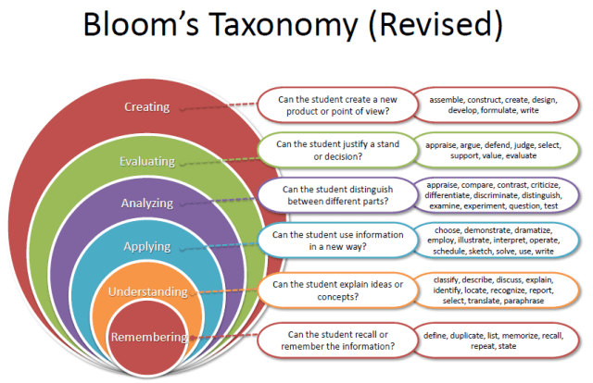
Revised Bloom’s Taxonomy
Notes:
Learning is not just memorizing
Focus on understanding, applying, analyzing, and creating
Encourages higher-order thinking
Example
Instead of just defining cyber crime, students analyze real cyber crime cases.

Slide 11
Course Contents
Unit 1: ETHICS
Definition of ethics, Importance of integrity, Ethics in business world, improving corporate ethics, Creating an ethical work environment, Ethical decision making, Ethics in information technology, Ethical behavior of IT professional, Common ethical issues for IT users, Supporting the ethical practices of IT users
Unit 2: INTELLECTUAL PROPERTIES
Different kinds of marks (brand names, logos, signatures, symbols, well known marks, certification marks and service marks), Patents, Importance of Patent Information in Business Development, Concept of Intellectual Property, Copyrights, Trademarks
Unit 3: GOVERNMENT FUNDING AND SCHEMES FOR STARTUPS
what are Startups, Startup India benefits, Resources, bank loan for start up business, Start-up India, 10000 startups -A NASSCOM Initiative, Export promotion schemes: Software Technology Parks (STPs), Special Economic Zones (SEZ) Scheme, Laws for Startups
Notes:
Meaning of ethics and integrity
Ethics in business and IT
Ethical decision-making
Example
Refusing a bribe even if it benefits the company financially.
🔹 Unit 2: Intellectual Property Rights (IPR)
Bullet points
Patents, trademarks, copyrights
Importance of IP protection in innovation
Example
Copyright protection for software source code.
🔹 Unit 3: Government Funding & Startup Schemes
Bullet points
Startup India initiative
Bank loans and NASSCOM initiatives
STPI and SEZ schemes
Example
A student startup receiving seed funding under Startup India.

Slide 12
Course Contents
Unit 4: STARTUP IN IT
Planning of startup business in IT sector-Executive summary, General company Description, Products and services, Marketing plan, Operational plan, Management and organization, Personal Financial Statement, Startup Expenses and Capitalization, Financial Plan, Appendices, Refining the Plan, Examples of Successful Start-ups
Unit 5: COMPANIES
Introduction to IT and ITES industry (Product based, Services based), Introduction to NASSCOM, STPI, Overview on latest IT projects with global impact, Case study of an IT industry (Product based and Services based), Recent technology advancement, Current affairs related with the IT industry, Diversity in the Workforce
Unit 6: LEGAL, ETHICAL AND PROFESSIONAL ISSUES IN INFORMATION SECURITY
Introduction, Law and Ethics in Information Security, Organizational Liability and the Need for Counsel, Policy Versus Law, Cyber Crime, Cyber-crime on the rise, Cyber law of India, Need for cyber law in India
Notes:
Business plan preparation
Marketing and financial planning
Case studies of successful startups
Example
Preparing a startup plan for a mobile application.
🔹 Unit 5: IT & ITES Companies
Bullet points
Product vs service-based companies
Latest technologies and diversity
Global IT projects
Example
Diversity programs in multinational IT companies.
🔹 Unit 6: Legal & Ethical Issues in Information Security
Bullet points
Cyber law in India
Cyber crimes and legal responsibilities
Importance of organizational policies
Example
Legal punishment for data theft under Indian cyber law.

Slide 13
Course Assessment Model
Marks break up
Attendance
CA
5
25
20
50
100
MTE
ETE
Total

Slide 14
Detail of Academic Tasks
AT1:Test1 (IPR)
(Before MTE)
Lecture #06
AT2:Test2(MCQ based)
(After MTE)
Lecture #18

Slide 15
Cohort
Entrepreneurship
Entrepreneurship
Government jobs
Higher studies
Notes:
This slide is about career pathways.
Strong foundation in ethics and integrity
Understanding laws, cyber law of India
Awareness of social and legal responsibilities
Useful for exams like:
UPSC
SSC
State government exams
PSU interviews
Practical Example
A cybercrime officer must know:
What is legally allowed
What evidence is admissible
Ethical handling of sensitive data

Slide 16
SkillSet
Logical Thinking
Technical Competence
Publication
Patent/ Copyright
Interpersonal Skills

Slide 17

Text /Reference Book
Text Book
ETHICS 101
Author: JOHN .C MAXWELL
Publisher: Hachette India

Slide 18

UNIT 1: ETHICS

Slide 19


UNIT 2: INTELLECTUAL PROPERTIES

Slide 20

UNIT 3: GOVERNMENT FUNDING AND SCHEMES FOR STARTUPS

Slide 21

UNIT 4: STARTUP IN IT

Slide 22

UNIT 5: COMPANIES

Slide 23
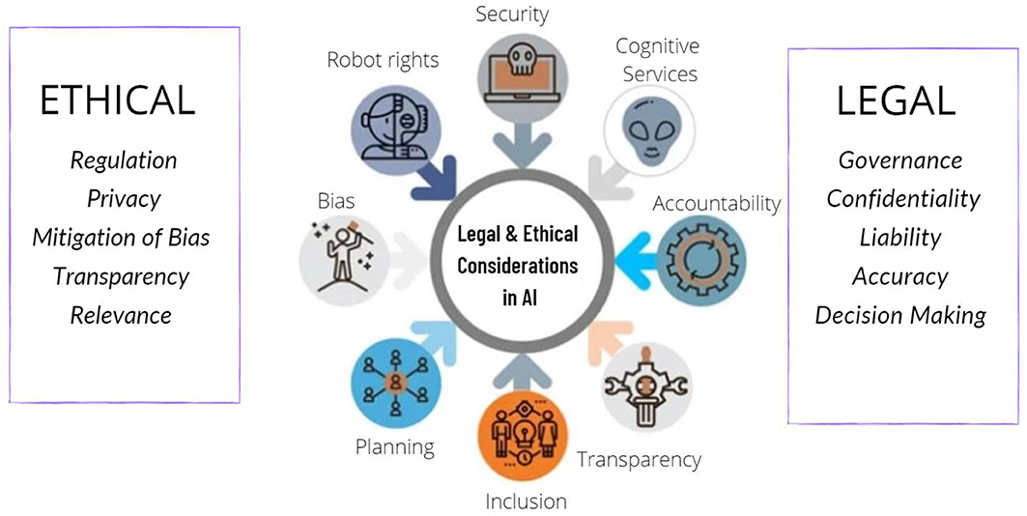
UNIT 6: LEGAL, ETHICAL AND PROFESSIONAL ISSUES IN INFORMATION SECURITY

Slide 24
EDU-Revolution Categories
Revenue Generation
Social Media Presence
Project
Recognition of Prior Learning
NPTEL/MOOC
Grade Upgradation (Core/Non-Core)
Internship Beyond the Curriculum
Community Service
Co-curricular/Extra curricular activities
10% Attendance Benefit
Duty Leave
Earn Extra Credit

Slide 25


EDUCATION REVOLUTION @
“…Gamified Learning”

Slide 26
THEME OF EDUCATION REVOLUTION
GAMIFIED LEARNING

Slide 27
The Beginning: BE THE CHANGE
Personalized, Student-Centric Learning: Tailored academic pathways to meet individual learning needs.
Beyond the Classroom: Enabling students to explore, engage, and excel through flexible learning platforms.
Academic Agility: Freedom to choose and customize key academic areas to match students' aspirations.
Real-World Integration: Moving beyond traditional pen-and-paper methods to hands-on, practical learning.
Experiential Learning Focus: Bridging theory with real-world practice to enhance skills and competencies.
Holistic Development: Fostering intellectual, emotional, and social growth for well-rounded graduates.

Slide 28
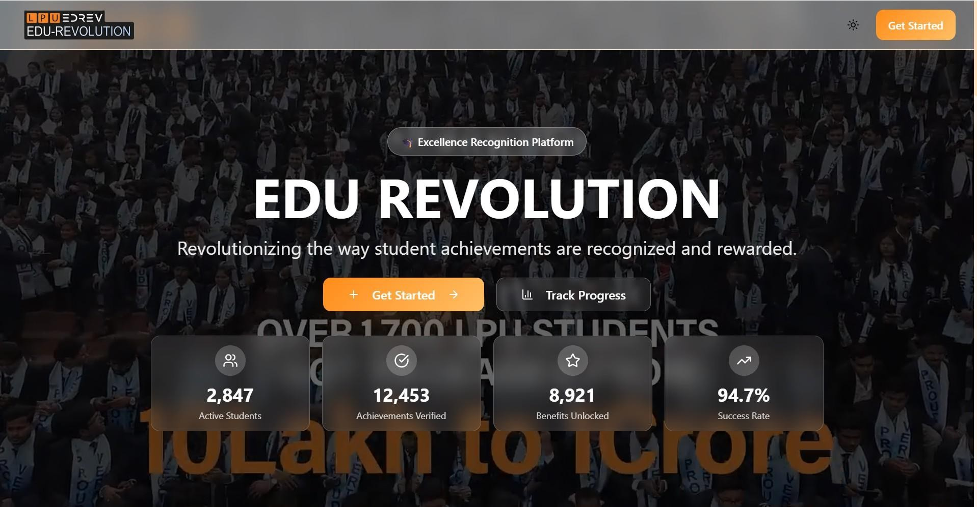
EDU-REVOLUTION INTERFACE
Step 1: Access the EDU-Revolution Portal
Navigate through UMS → LMS → EDU-Revolution: Be the Change,
or click the dashboard shortcut “Apply for EDU-Revolution.” and click on “Get Started” to see the categories

Slide 29
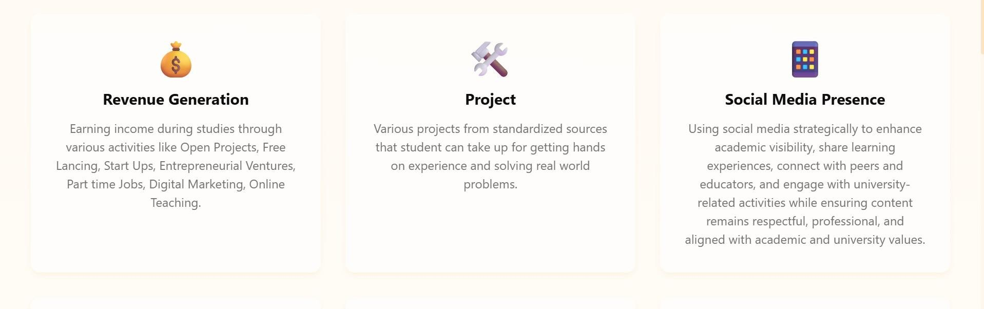
EDU-REVOLUTION INTERFACE
Step 2: Choose a Category
Select the category for which you want to submit your nomination.

Slide 30
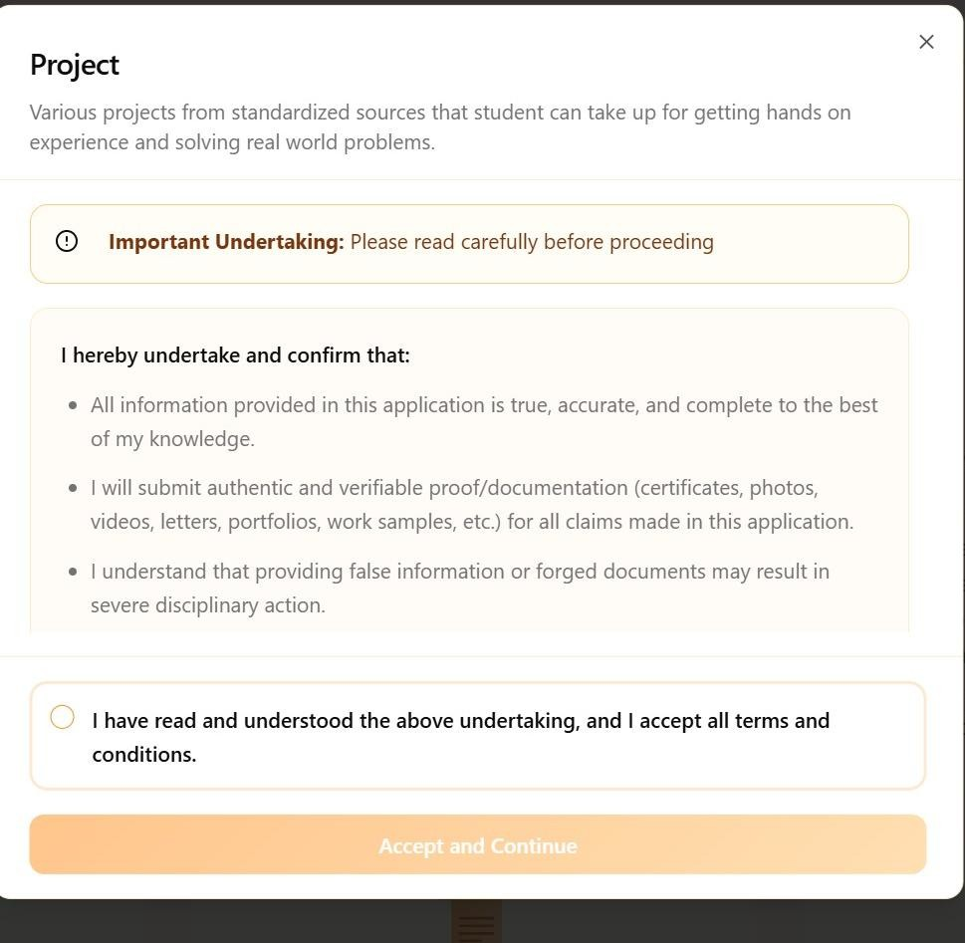
EDU-REVOLUTION INTERFACE
Step 3 : Read the undertaking carefully
Click on Accept and continue to see the course list.

Slide 31
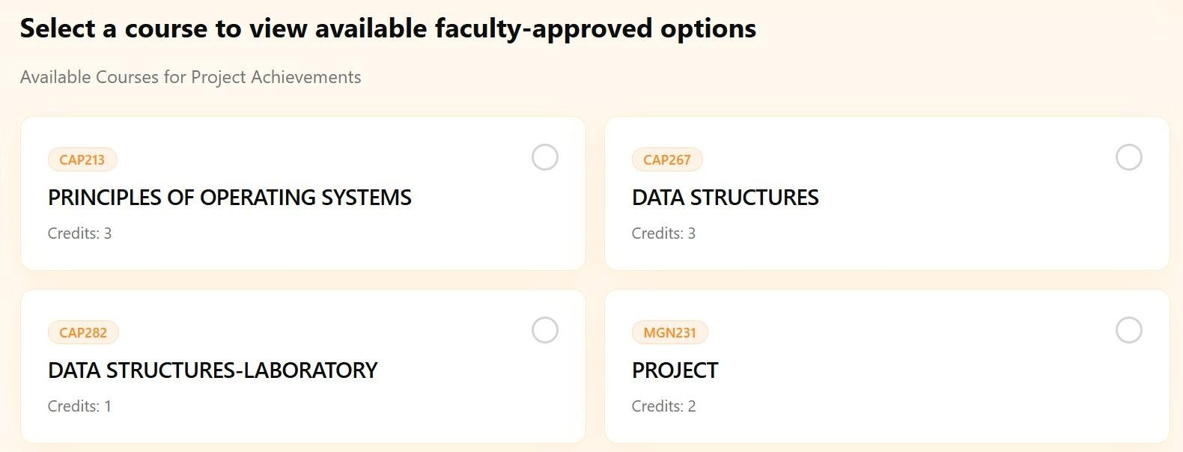
Step 4: Review Expert-Defined Options
Explore the list of courses in which you can express your interest.

Slide 32
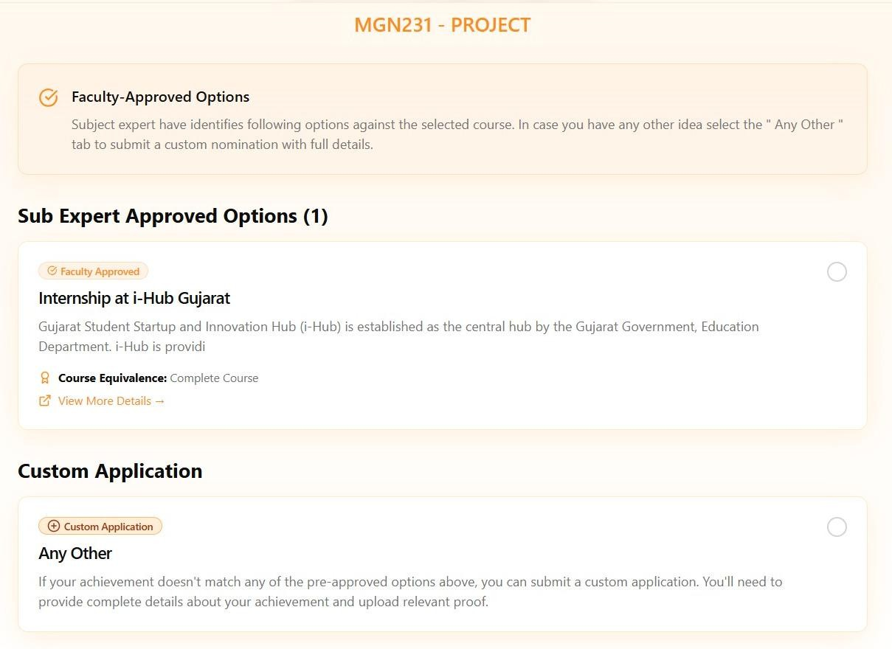
Step :: 5 Review Expert-Defined Options
Explore the list of course-specific options
curated by subject experts, where you can express your interest.

Slide 33
Step 5 (a) ::Use the “Any Other” Option if Needed
If your preferred option is not listed, choose the “Any Other” option shown under the course.

Slide 34
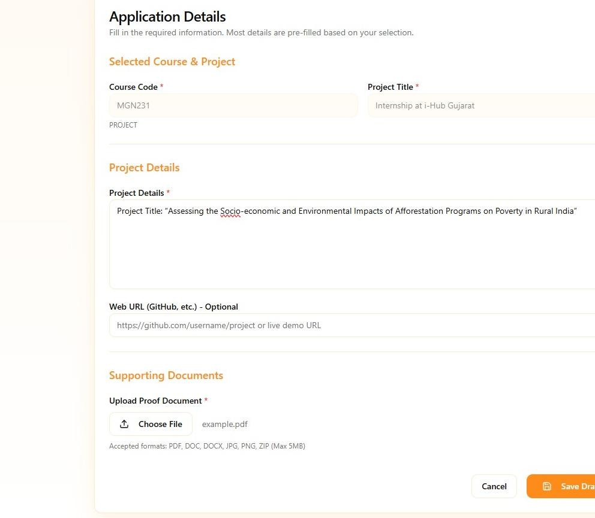
Step 6:: Fill all the relevant details and upload the required proof and click on save draft

Slide 35
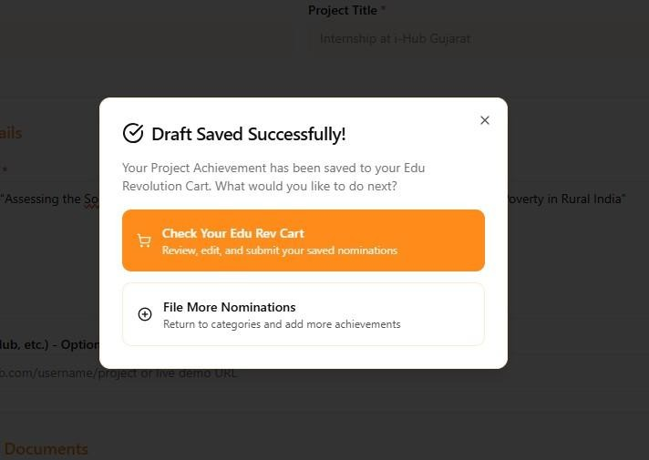

Step 7 :: Your nomination shall be added in the EDU-Revolution Cart: Which you can Review, Modify, and Remove

Slide 36
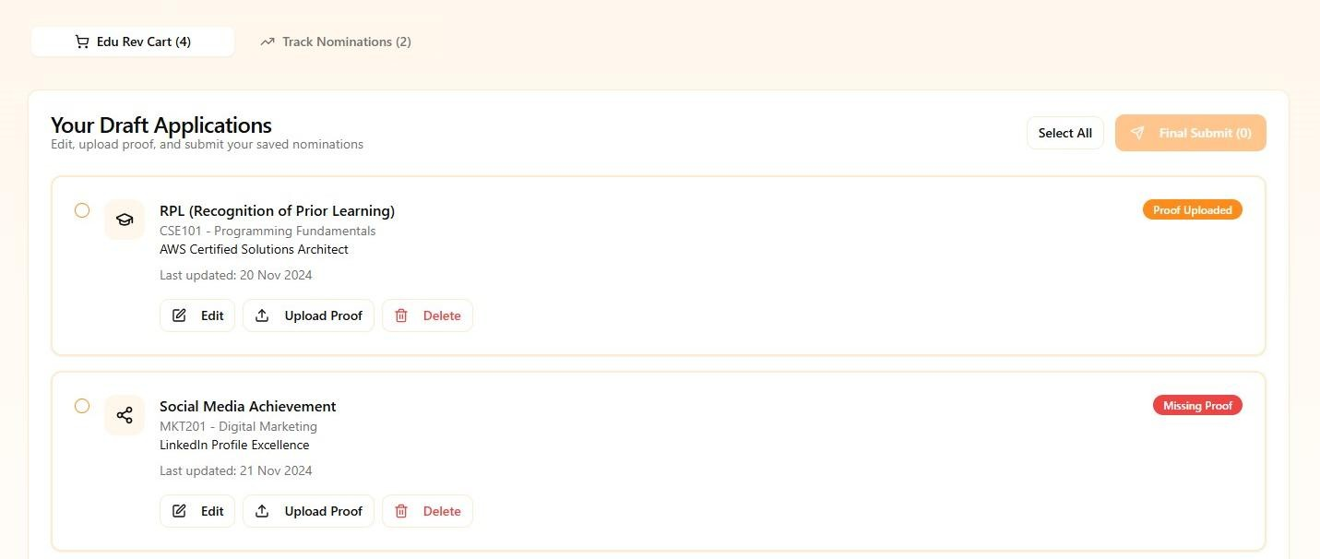
Step 8:: Your nomination shall be added in the EDU-Revolution Cart: Which you can Review, Modify, and Remove. You have to click on “Final Submit” for submission of your nominations.

Slide 37
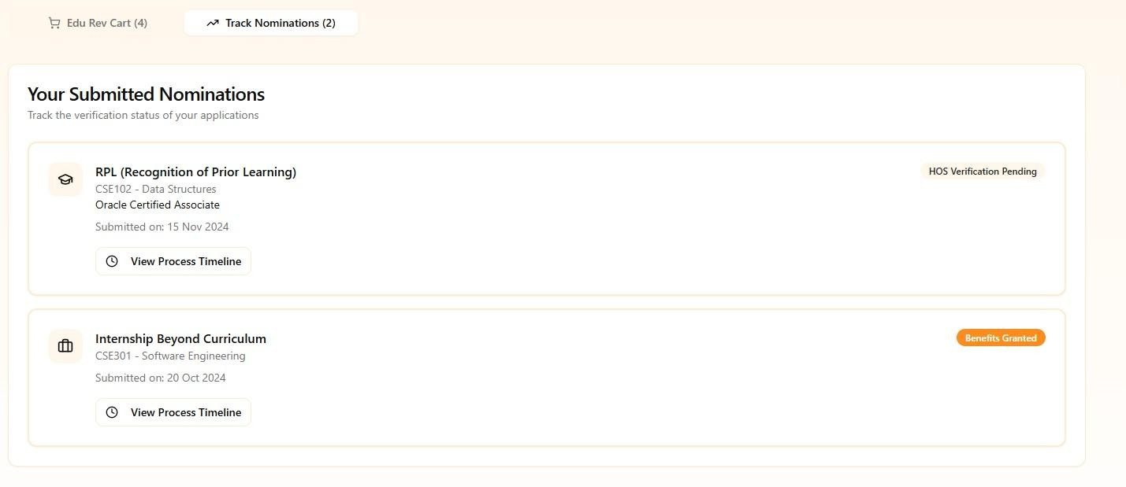
Your can track the progress from the Track Progress tab provided

Slide 38
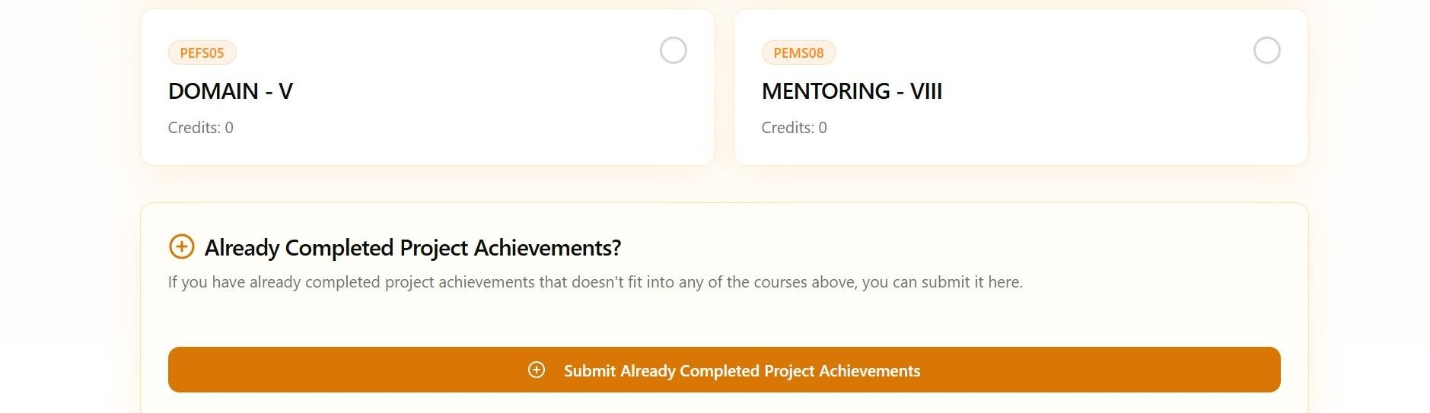
Submit Completed Initiatives
If you have already completed an initiative, upload your achievement using the “Already Completed” button and repeat the steps from Step-6 to Step-8

Slide 39
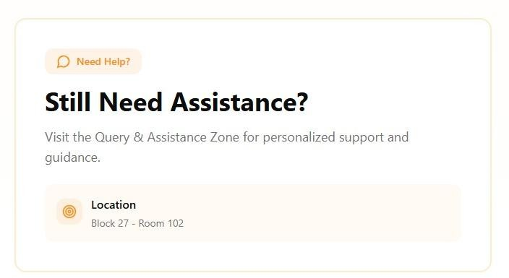
Query and Assistance Zone

Slide 40
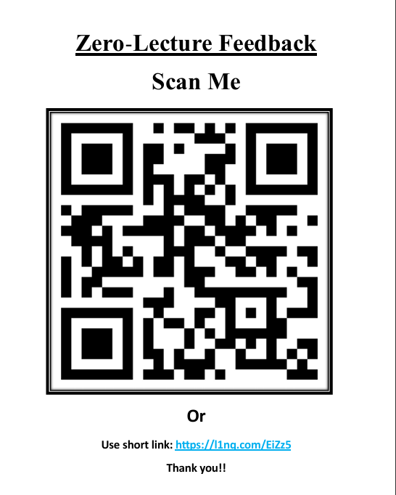

Slide 41
Thank You

